Slide 1


Qafny: A Quantum-Program Verifier
By Liyi Li, et al.
Henry Allard in ECOOP 2024
Notes:
Good afternoon esteemed researchers of ECOOP 2024, my name is Henry Allard, and I’m an undergraduate computer science researcher at Iowa State University working under Dr. Liyi Li. Unfortunately, Dr. Li couldn’t attend ECOOP this year, so please accept me as a willing sacrifice in his stead. I will be presenting his research paper titled: Qafny: A Quantum Program Verifier.

Slide 2
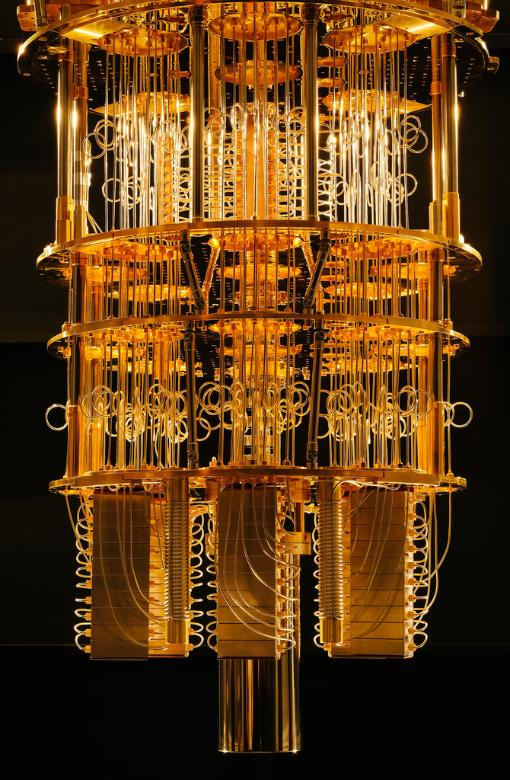
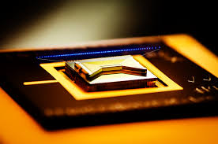
Quantum Computing
Notes:
See First few paragraphs in the paper, explain briefly what is quantum computers with its features:
Quantum computers can be used to program substantially faster algorithms than those written for classical computers.

Slide 3
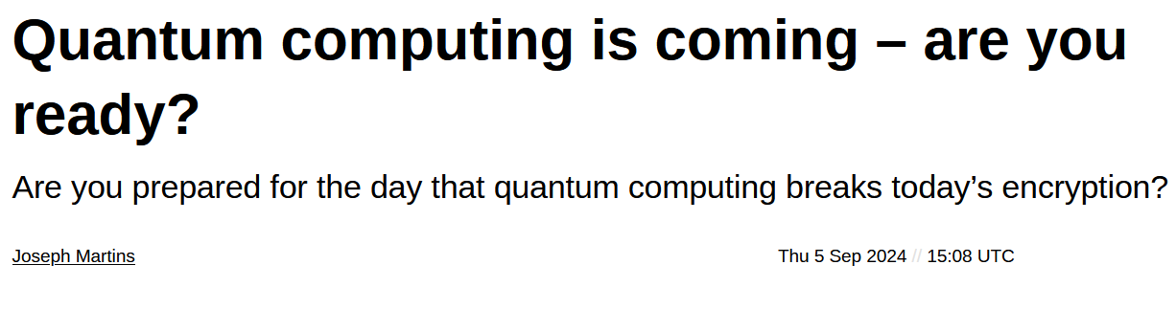
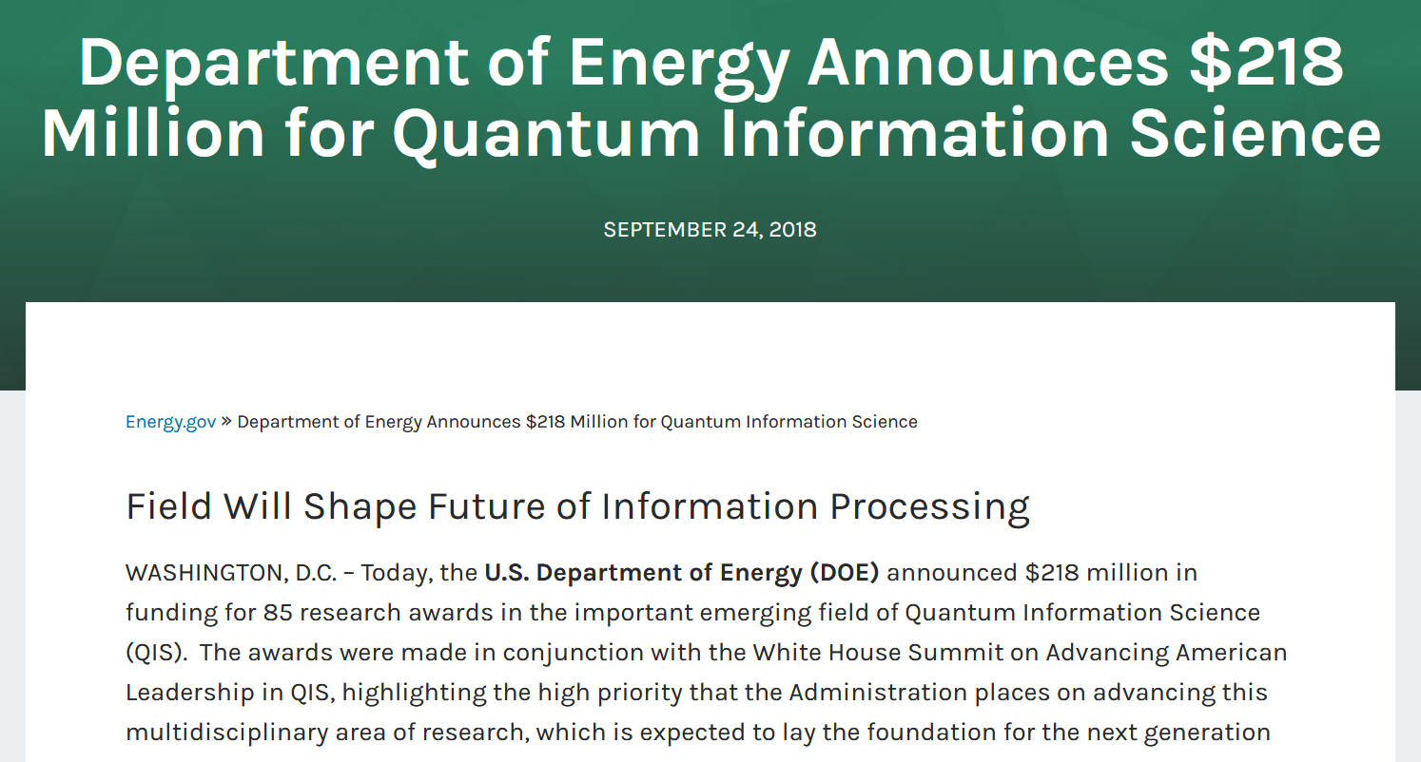

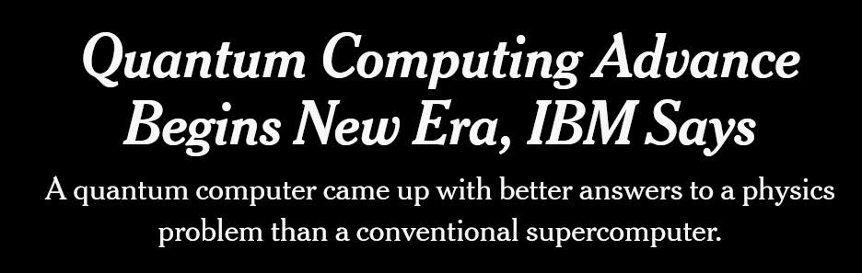
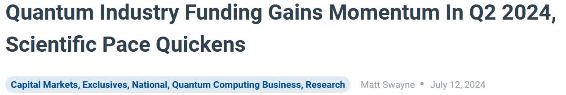
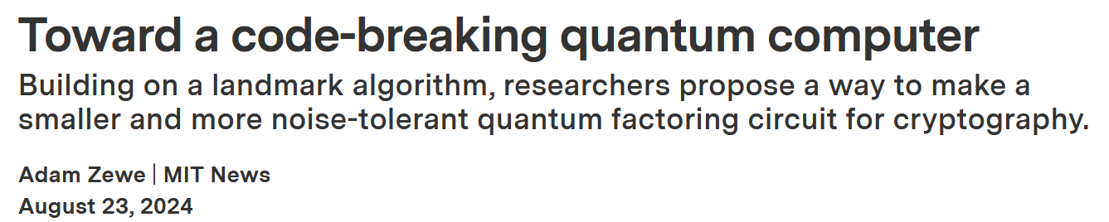
Quantum Computing
Notes:
Explain the key advantanges and prospects of quantum computers.
First, some background for the project:
The research community at large has seen an increased focus on Quantum computers in recent years. (here are a few news articles, ranging from informative to sensationalist) But why is that? Quantum computers can be used to program substantially faster algorithms than those written for classical computers. They will unlock speedups of orders of magnitudes for complex problems such as cryptography, gene folding, and data processing (artificial intelligence).

Slide 4
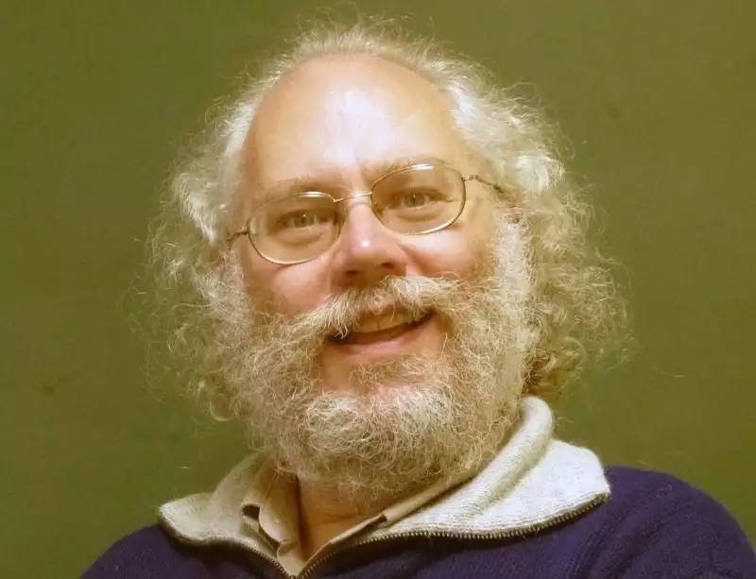
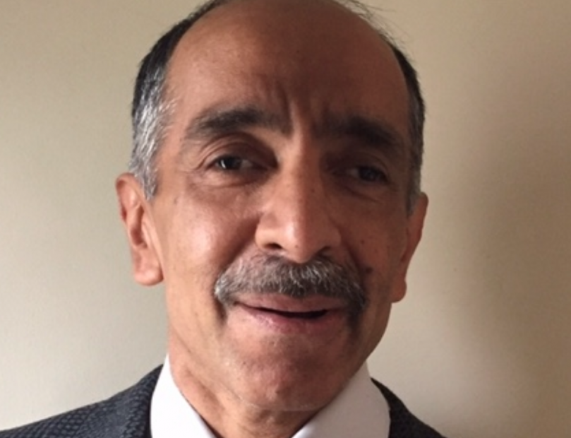
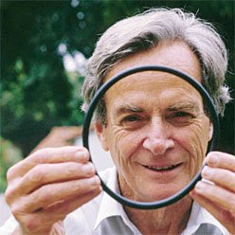
Why?
Factoring large numbers (Shor’s)
polynomial vs. super-polynomial
Unstructured search (Grover’s)
sub-linear vs. linear
Simulating physical systems
Solving linear equations
Peter Shor
Lov Grover
Richard Feynman
Notes:
Here is a list of example applications of quantum algorithms. Shor’s algorithm is probably the most well-known, because it can be attached to the biggest, sensationalist headlines. QUANTUM COMPUTING HACKS ALL COMPUTERS. (Because Shor’s can be used to break encryption). Grover’s algorithm is also quite useful when searching for a specific value quicker than classical algorithms. Quantum algorithms can also be used to simulate physical systems and solve complex linear equations. Unfortunately, physical hardware hasn’t come to the stage of being viable for real world uses of these algorithms yet. However, the research must grow!

Slide 5
Current Situation
We have quantum computers (IBMQ): noisy and limited.
There are quantum algorithms: most are on paper.
Some quantum computation models are proposed: qram, circuit models.
Few frameworks proposed for quantum languages: run on simulators.

Slide 6
Need Tools to Understand/Verify Quantum Programs
Most of the work → done by researchers know physics.
Need tools for general computer programmers to work with.
Quantum computer resources are limited, is there an effective way of representing a program, so that it can run on the limited resource environment?
Quantum terms and states are hard to understand, is there a good way to write and verify quantum programs?
More use cases of quantum algorithms?
Notes:
However, designing and building these quantum algorithms takes an intense amount of effort. Truly understanding quantum requires combining physics, math and computer science at the doctoral level. Proving these algorithms is also difficult work mired by the intense work of reasoning around quantum operations. Most of this work is done by researchers in math and physics, not programmers. The Quantum algorithm industry lacks the tools needed for general computer programmers. How can we represent quantum programs efficiently? Succinctly? Expressively? Wouldn’t it be nice if a program existed to assist this process?

Slide 7
Qafny
A proof system suitable for automatically verifying quantum programs.
Based on classical verification infrastructures: Separation Logic.
Dual views of quantum programs.
Quantum states → arrays, quantum Ops → aggregate array ops.
Enforced by a type system.
Verified programs → used in compiled quantum circuits.
Verified compilation.
Program verification logic different from the compiled circuit semantics.
Notes:
Indeed it would! This was the initial reasoning behind creating Qafny, a programming language built with Dafny to assist in writing and proving Quantum algorithms. Qafny supports built-in vertification techniques such as separation logic and representing different qubits as concrete types. Under the hood it works by encoding quantum states and operations as arrays. Qafny works by verifying the quantum programs and then compiling them directly to QASM. This logic has been split between verifying the program and generating the compiled code.

Slide 8
Qafny
A proof system suitable for automatically verifying quantum programs.
Based on classical verification infrastructures: Separation Logic.
Dual views of quantum programs.
Quantum Ops → aggregate array, quantum states → arrays.
Enforce by a type system.
Verified programs → used in compiled quantum circuits.
Verified compilation.
Program verification logic different from the compiled circuit semantics.
Quantum programs are not effectively simulatable in classical computers,
but they are verifiable in the computers.
Notes:
An important caveat is that even though quantum algorithms are insanely difficult to run on classical hardware, they can be verified by the CPU in your laptop.

Slide 9
Qafny Today
Quantum states and operations.
Qafny design principle.
Qafny types.
Thoughts of Qafny proofs an example.
Evaluation.

Slide 10

How quantum programs work? Quantum won’t replace your laptop.

Slide 11
This is the “qram” model.
New Qunity Model in this year’s POPL!
Classical language
Quantum language

Slide 12
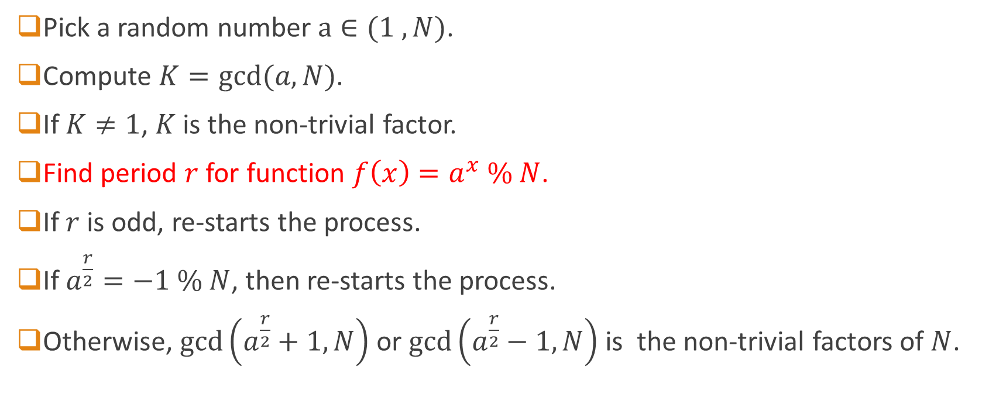

Shor’s algorithm de-factorizes integer $N$.
Pick a random number $a∈(1 ,N)$.
Compute $K=gcd⁡(a,N)$.
If $K≠1$, $K$ is the non-trivial factor.
Find period $r$ for function $f\left(x\right)=a^{x} \% N$.
If $r$ is odd, re-starts the process.
If $a^{\frac{r}{2}}=−1 \% N$, then re-starts the process.
Otherwise, $\gcd\left(a^{\frac{r}{2}}+1,N\right)$ or $\gcd\left(a^{\frac{r}{2}}−1,N\right)$ is the non-trivial factors of $N$.

Slide 13
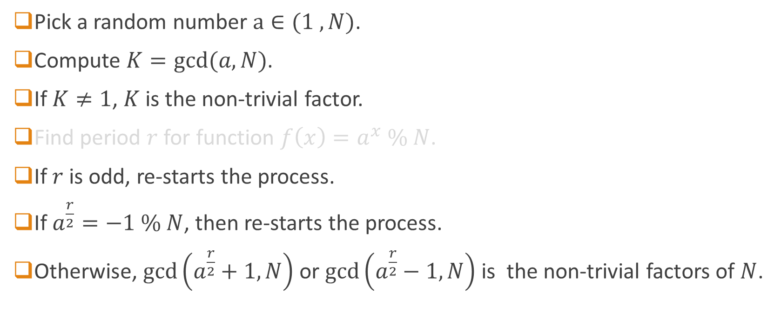
Shor’s algorithm de-factorizes integer $N$.
Pick a random number $a∈(1 ,N)$.
Compute $K=gcd⁡(a,N)$.
If $K≠1$, $K$ is the non-trivial factor.
Find period $r$ for function $f\left(x\right)=a^{x} \% N$.
If $r$ is odd, re-starts the process.
If $a^{\frac{r}{2}}=−1 \% N$, then re-starts the process.
Otherwise, $\gcd\left(a^{\frac{r}{2}}+1,N\right)$ or $\gcd\left(a^{\frac{r}{2}}−1,N\right)$ is the non-trivial factors of $N$.

Slide 14
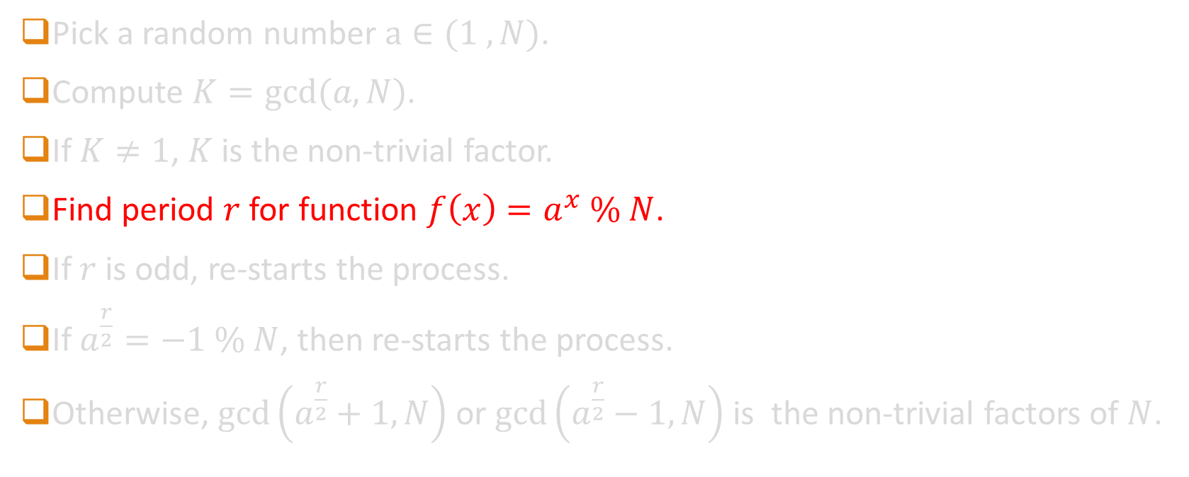
Shor’s algorithm de-factorizes integer $N$.
Pick a random number $a∈(1 ,N)$.
Compute $K=gcd⁡(a,N)$.
If $K≠1$, $K$ is the non-trivial factor.
Find period $r$ for function $f\left(x\right)=a^{x} \% N$.
If $r$ is odd, re-starts the process.
If $a^{\frac{r}{2}}=−1 \% N$, then re-starts the process.
Otherwise, $\gcd\left(a^{\frac{r}{2}}+1,N\right)$ or $\gcd\left(a^{\frac{r}{2}}−1,N\right)$ is the non-trivial factors of $N$.

Slide 15
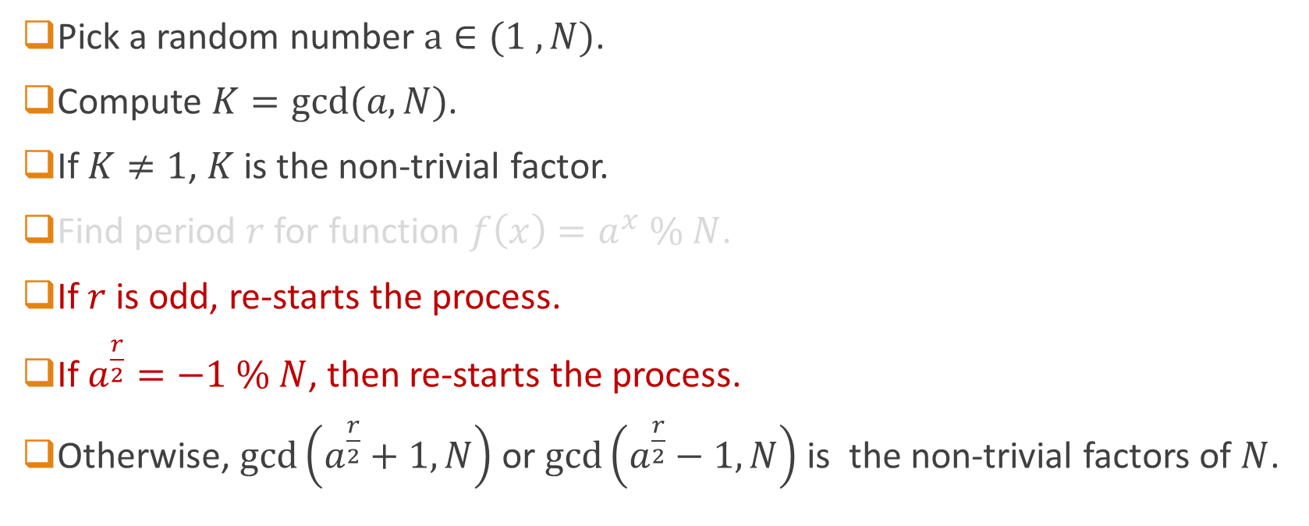
Shor’s algorithm de-factorizes integer $N$.
Pick a random number $a∈(1 ,N)$.
Compute $K=gcd⁡(a,N)$.
If $K≠1$, $K$ is the non-trivial factor.
Find period $r$ for function $f\left(x\right)=a^{x} \% N$.
If $r$ is odd, re-starts the process.
If $a^{\frac{r}{2}}=−1 \% N$, then re-starts the process.
Otherwise, $\gcd\left(a^{\frac{r}{2}}+1,N\right)$ or $\gcd\left(a^{\frac{r}{2}}−1,N\right)$ is the non-trivial factors of $N$.

Slide 16
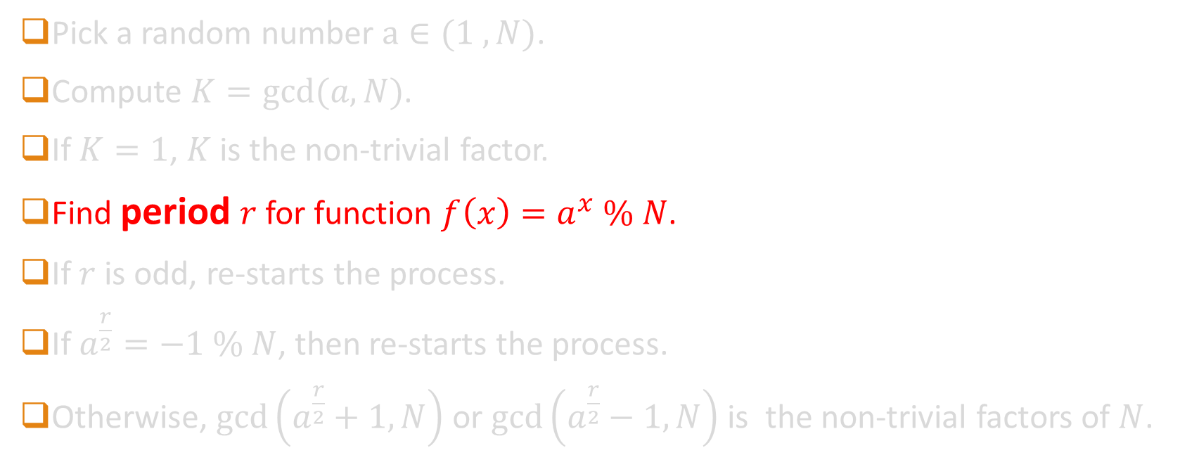
Shor’s algorithm de-factorizes integer $N$.
Pick a random number $a∈(1 ,N)$.
Compute $K=gcd⁡(a,N)$.
If $K=1$, $K$ is the non-trivial factor.
Find period $r$ for function $f\left(x\right)=a^{x} \% N$.
If $r$ is odd, re-starts the process.
If $a^{\frac{r}{2}}=−1 \% N$, then re-starts the process.
Otherwise, $\gcd\left(a^{\frac{r}{2}}+1,N\right)$ or $\gcd\left(a^{\frac{r}{2}}−1,N\right)$ is the non-trivial factors of $N$.
The task wanted is still classical!

Slide 17

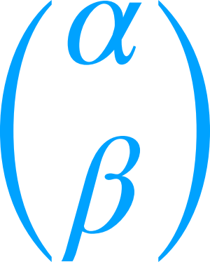



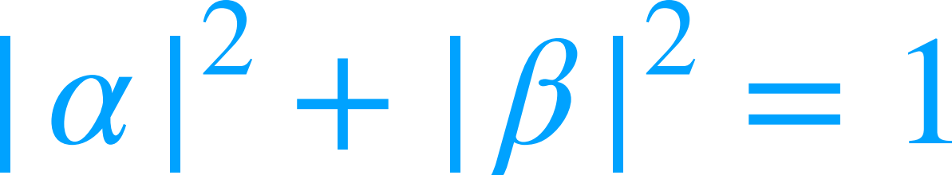
Quantum states are different.
Dirac Notation
amplitudes have unit norm
Notes:
We’re about to go into depth with an example, but we must first cover some background. On this slide you can see a qubit represented in vector, and dirac notation. Finally, you can also see that the two amplitudes of a qubit have a unit norm.

Slide 18
Quantum states allow superposition.
Dirac Notation
and
Notes:
Qubits (the smallest unit of quantum information) are typically represented as a pair of amplitudes that represent the probability that (when measured) the qubit is a 0 (alpha) or a 1 (beta). As a probability-analogy, their squares need to add up to 1. As such, we represent qubits as a “mix” between two different “states” or basis-kets, represented as pipe 0 right angle and pipe 1 right angle. This is called Dirac Notation.

Slide 19

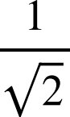

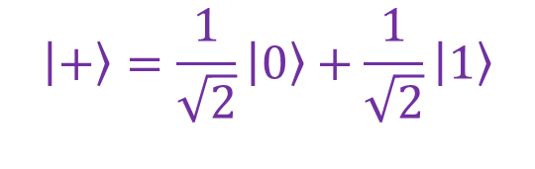
Quantum states allow superposition.
n-qubit system:
length-2^{n} vector
Superposition: Qubits can be in multiple states (0 or 1) at once
Dirac Notation
$$\left|+\right\rangle =\frac{1}{\sqrt{2}}\left|0\right\rangle +\frac{1}{\sqrt{2}}\left|1\right\rangle$$
Notes:
But these amplitudes don’t need to be a one or zero, they can be any real number in between. In fact, if the amplitudes are both 1 over square root 2, this is said to be in the “plus” state, that is pipe, plus, right angle. You can expand this out to an n-qubit system represented by a length 2^n vector.

Slide 20
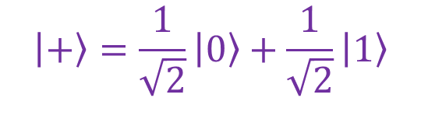
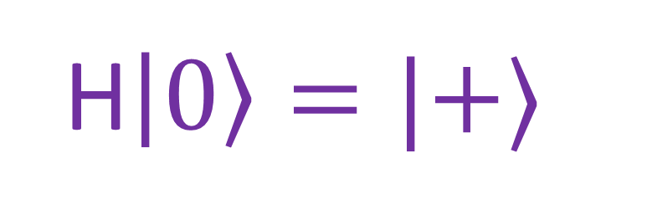
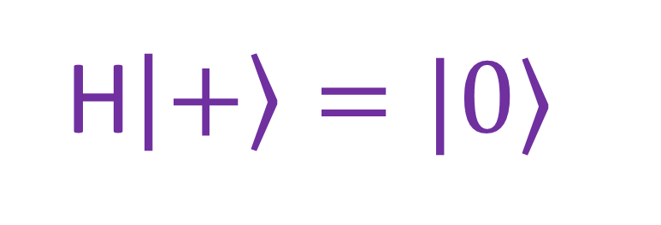
Quantum operations for superposition
$$\left|+\right\rangle =\frac{1}{\sqrt{2}}\left|0\right\rangle +\frac{1}{\sqrt{2}}\left|1\right\rangle$$
H$\left|+\right\rangle =|0⟩$
This is the Hadamard operator
H$\left|0\right\rangle =|+⟩$
It creates, and dispels, superpositions
Notes:
The Hadamard transforms to and from superpositions, where the amplitudes aren’t zero or one, and instead are both real numbers between.

Slide 21
Quantum Component General Structures
State Preparation
Quantum Oracles
Post Processing

Slide 22
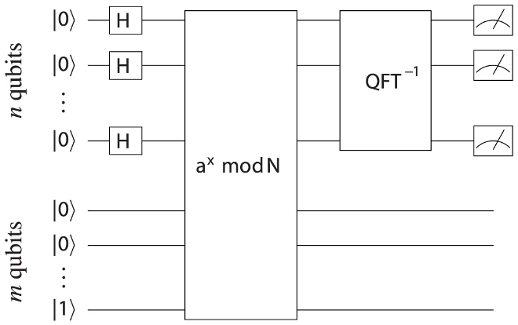
A Quantum Algorithm – Shor’s
prepare
initial state
(superposition)
postprocess
(measure
results)
perform oracle computation
(order finding)

Slide 23
A Quantum Algorithm – Shor’s
prepare
initial state
(superposition)
postprocess
(measure
results)
perform oracle computation
(order finding)

Slide 24
Quantum State Preparations
prepare
initial state
(superposition)

Slide 25
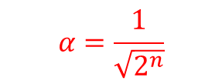
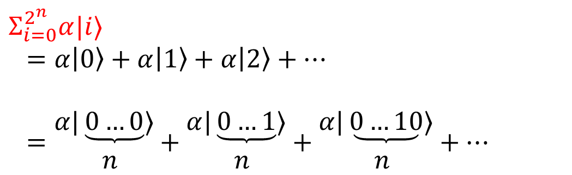
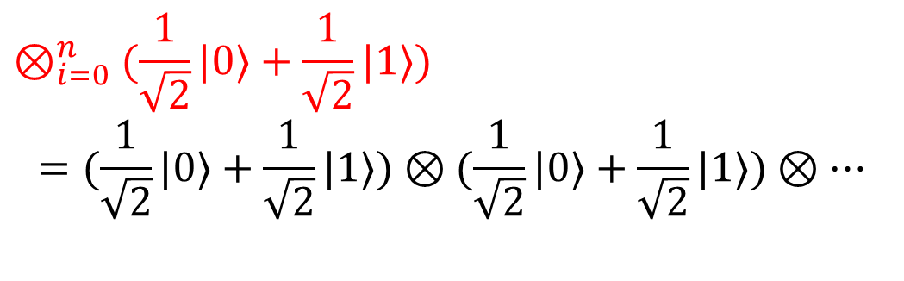
Applying H gates resulting in two forms.
$$⊗_{i=0}^{n}(\frac{1}{\sqrt{2}}|0⟩+\frac{1}{\sqrt{2}}|1⟩)$$
$$=(\frac{1}{\sqrt{2}}|0⟩+\frac{1}{\sqrt{2}}|1⟩)⊗(\frac{1}{\sqrt{2}}|0⟩+\frac{1}{\sqrt{2}}|1⟩)⊗…$$
prepare
initial state
(superposition)
$$⇔$$
$$Σ_{i=0}^{2^{n}}α|i⟩$$
$$=α\left|0\right\rangle +α\left|1\right\rangle +α\left|2\right\rangle +…$$
$$={α|\underbrace{0…0}⟩ \atop n}+{α|\underbrace{0…1}⟩ \atop n}+{α|\underbrace{0…10}⟩ \atop n}+…$$
$$α=\frac{1}{\sqrt{2^{n}}}$$

Slide 26
Applying H gates resulting in two forms.
$$⊗_{i=0}^{n}(\frac{1}{\sqrt{2}}|0⟩+\frac{1}{\sqrt{2}}|1⟩)$$
$$=(\frac{1}{\sqrt{2}}|0⟩+\frac{1}{\sqrt{2}}|1⟩)⊗(\frac{1}{\sqrt{2}}|0⟩+\frac{1}{\sqrt{2}}|1⟩)⊗…$$
prepare
initial state
(superposition)
$$⇔$$
Tensor product formula.
Easy to be viewed as a map of H gate app.
Use cases are limited.
$$Σ_{i=0}^{2^{n}}α|i⟩$$
$$=α\left|0\right\rangle +α\left|1\right\rangle +α\left|2\right\rangle +…$$
$$={α|\underbrace{0…0}⟩ \atop n}+{α|\underbrace{0…1}⟩ \atop n}+{α|\underbrace{0…10}⟩ \atop n}+…$$
$$α=\frac{1}{\sqrt{2^{n}}}$$

Slide 27
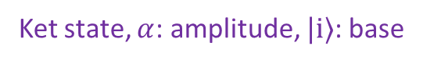
Ket state notation is universal.
$$⊗_{i=0}^{n}(\frac{1}{\sqrt{2}}|0⟩+\frac{1}{\sqrt{2}}|1⟩)$$
$$=(\frac{1}{\sqrt{2}}|0⟩+\frac{1}{\sqrt{2}}|1⟩)⊗(\frac{1}{\sqrt{2}}|0⟩+\frac{1}{\sqrt{2}}|1⟩)⊗…$$
prepare
initial state
(superposition)
$$⇔$$
General enough, but hard to think of it as
classical map op.
Ket state, $α$: amplitude, $|i⟩$: base
$$Σ_{i=0}^{2^{n}}α|i⟩$$
$$=α\left|0\right\rangle +α\left|1\right\rangle +α\left|2\right\rangle +…$$
$$={α|\underbrace{0…0}⟩ \atop n}+{α|\underbrace{0…1}⟩ \atop n}+{α|\underbrace{0…10}⟩ \atop n}+…$$
$$α=\frac{1}{\sqrt{2^{n}}}$$

Slide 28
Ket state notation is universal.
$$⊗_{i=0}^{n}(\frac{1}{\sqrt{2}}|0⟩+\frac{1}{\sqrt{2}}|1⟩)$$
$$=(\frac{1}{\sqrt{2}}|0⟩+\frac{1}{\sqrt{2}}|1⟩)⊗(\frac{1}{\sqrt{2}}|0⟩+\frac{1}{\sqrt{2}}|1⟩)⊗…$$
prepare
initial state
(superposition)
$$⇔$$
Both integer and bitstring formats can
be useful in different algorithms.
$$Σ_{i=0}^{2^{n}}α|i⟩$$
$$=α\left|0\right\rangle +α\left|1\right\rangle +α\left|2\right\rangle +…$$
$$={α|\underbrace{0…0}⟩ \atop n}+{α|\underbrace{0…1}⟩ \atop n}+{α|\underbrace{0…10}⟩ \atop n}+…$$
$$α=\frac{1}{\sqrt{2^{n}}}$$

Slide 29
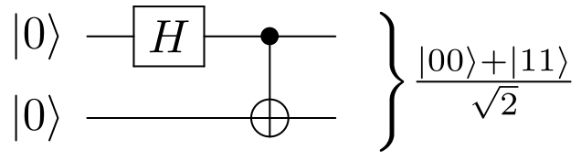
Model Quantum Entanglement
Bell state!
Entangled state cannot be written as $\left(a\left|0\right\rangle +b|1⟩\right)⊗\left(c\left|0\right\rangle +d|1⟩\right)$
Notes:
Example: Bell Pair, takes in two qubits (both 0) and transforms them into superposition where the first qubit is equal to the second. The output cannot be written as open parentheses a ket zero plus b ket one close parentheses tensor with open parentheses c ket zero plus d ket 1 close parentheses. It must be written as ket zero zero plus ket one one all over square root 2. Why is that?

Slide 30
Quantum entanglement in ket states.
First qubit!
The first position bit in each ket state (separated by +) is the first qubit.
Notes:
It has to do with how Bell Pair works. The first position in each ket is the first qubit

Slide 31
Quantum entanglement in ket states.
Second qubit!
The second position bit in each ket state (separated by +) is the second qubit.
Notes:
The second is the second qubit. The addition sign denotes that only these two ket (i.e. zero zero or one one) can exist upon termination of this program. How can we figure out which state actually exists?

Slide 32
Measuring an entangled state.
Measure the first qubit.
If we measure the first qubit and get zero, it means the second qubit must be zero!
Notes:
By measuring the first qubit. If the result of measuring the first qubit is a zero, that must mean the second qubit is zero. Likewise, if the result of measuring the first qubit is a one, that must mean the second qubit is a one.

Slide 33
Measuring an entangled state.
If zero at the first bit, second one must be zero
If we measure the first qubit and get zero, it means the second qubit must be zero!
Notes:
Again, reiterating, if the measurement of the first qubit is a zero, the second qubit cannot be one and vice versa.

Slide 34
Qafny Design Principle
When verifying quantum programs → Don’t expand out the semantics of programs with respect to quantum states.
Quantum program state transitions are exponential!
Partition quantum states into different types.
Transform quantum program verification to predicate constraint solving (solvable in SMT solver) by predicate transformers.
Abstract quantum circuits as C-like programs.
Thus, we are able to compile quantum program verification to Dafny verification.
Notes:
When designing Qafny, Dr. Li had 4 main goals in mind:
Don’t expand out semantics needlessly. Quantum state transitions are exponential; and can lead to an explosion of the potential state space. There needs to be semantics to write states succinctly.
Different quantum states should be represented by different types. Programmers needn’t concern themselves with the amplitude and phase of the qubit if they solely care about qubits that aren’t entangled/probabilistic.
Program verification should be specified with SMT like predicates about the pre and post state for the program.
Quantum programs should be abstracted from the nitty gritty details of our physical reality.
And thus, we can compile quantum programs to Dafny for verification.

Slide 35
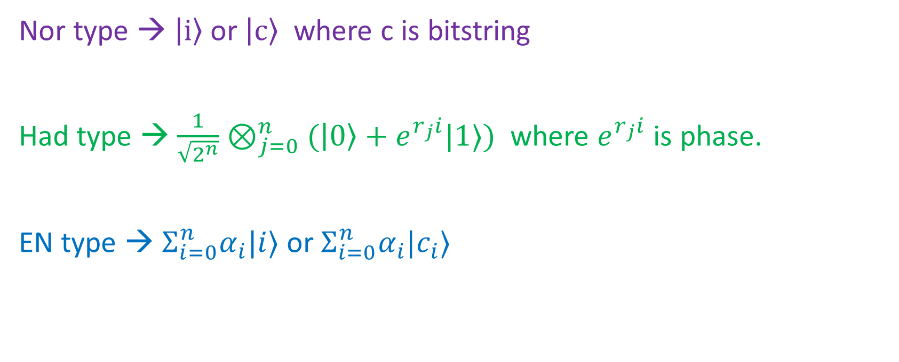
The idea can be generalized.
Nor type → $\left|i\right\rangle$or $\left|c\right\rangle$ where c is bitstring
Had type → ${\frac{1}{\sqrt{2^{n}}}⊗}_{j=0}^{n}(\left|0\right\rangle +e^{r_{j}i}|1⟩)$ where $e^{r_{j}i}$ is phase.
EN type → $Σ_{i=0}^{n}α_{i}|i⟩$ or $Σ_{i=0}^{n}α_{i}|c_{i}⟩$
Nor type can be represented as an array of string
(amplitude whose norm is 1).
Notes:
Nor types are used when the qubit is not in superposition, represented either as a solitary 0 or 1 in a ket or as a string of zeros and ones in a ket.

Slide 36
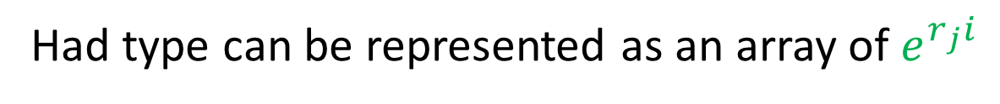
The idea can be generalized.
Nor type → $\left|i\right\rangle$or $\left|c\right\rangle$ where c is bitstring
Had type → ${\frac{1}{\sqrt{2^{n}}}⊗}_{j=0}^{n}(\left|0\right\rangle +e^{r_{j}i}|1⟩)$ where $e^{r_{j}i}$ is phase.
EN type → $Σ_{i=0}^{n}α_{i}|i⟩$ or $Σ_{i=0}^{n}α_{i}|c_{i}⟩$
(amplitude whose norm is 1).
Had type can be represented as an array of $e^{r_{j}i}$
Notes:
Had (or Hadamard type) is used for qubits in superposition, and the amplitude is fixed at 1/sqrt(2^n), but the phase can be specified by the programmer.

Slide 37
The idea can be generalized.
Nor type → $\left|i\right\rangle$or $\left|c\right\rangle$ where c is bitstring
Had type → ${\frac{1}{\sqrt{2^{n}}}⊗}_{j=0}^{n}(\left|0\right\rangle +e^{r_{j}i}|1⟩)$ where $e^{r_{j}i}$ is phase.
EN type → $Σ_{i=0}^{n}α_{i}|i⟩$ or $Σ_{i=0}^{n}α_{i}|c_{i}⟩$
(amplitude whose norm is 1).
EN type can be represented as an array of ket states: $α_{i}|c_{i}⟩$
Notes:
The EN type can be used when the programmer needs to specify the amplitude, phase and the basis kets and can be represented as an array of ket states. Both the Nor and Had type can be represented by the EN type but it is a lot easier on the programmer to use the simpler types if their requirements won’t stretch beyond the type bounds.

Slide 38
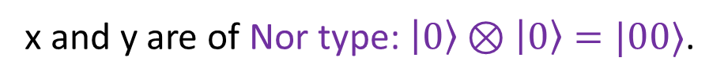
Proof using a Qafny type (Before H).
x
y
x and y are of Nor type: $\left|0\right\rangle ⊗\left|0\right\rangle =|00⟩$.
Notes:
With the newfound understanding of Qafny program types, we can finally analyze the Bell Pair state. Starting with the initial program values: (at the dotted line) we will represent the two qubits as x and y respectively. They start off in the Nor type with values ket 0 and ket 0 respectively.

Slide 39
Example proof using Qafny type (after H).
x
y
x has type Had: $\frac{1}{\sqrt{2}}(\left|0\right\rangle +|1⟩)$, and y has type Nor: $|0⟩$.
Notes:
Once the program has passed the Hadamard gate, the x value is of the had type (ket plus) and y is unchanged of type nor with the value ket 0.

Slide 40
Example proof using Qafny type (cast).
We have Had, but we see a CNOT,
so we need x and y in the same group,
and they are in EN.
x
y
x has type Had: $\frac{1}{\sqrt{2}}(\left|0\right\rangle +|1⟩)$, and y has type Nor: $|0⟩$.
Notes:
At this point, Qafny will see that we have a cnot gate (that’s the dark dot with the line connecting x and y). As such, we need x and y to be in the same type, so Qafny will convert them to EN type.

Slide 41
Example proof using Qafny type (cast).
First, apply a cast.
x
y
Cast x to be type EN: $Σ_{i=0}^{2}\frac{1}{\sqrt{2}}|i⟩$, and y has type Nor: $|0⟩$.
Notes:
First, Qafny casts x to the EN type with a simple summation over 0 to two of the two basis kets (ket 0 and ket 1, both with amplitude 1/sqrt(2).

Slide 42
Example proof using Qafny type (cast).
Then, a join.
cast and join are implemented
as an automatic inserted conversions in our Qafny compilation to Dafny!
x
Array aggregate map operation
of cat 0 at the end.
y
Join x and y to be type EN: $Σ_{i=0}^{2}\frac{1}{\sqrt{2}}\left|i\right\rangle \left|0\right\rangle ←\left(\frac{1}{\sqrt{2}}Σ_{i=0}^{2}|i⟩\right)⊗|0⟩$
Notes:
Then, Qafny will automatically cast y to EN type and join them together with an aggregate map operation. This is automatically inserted by Qafny as an abstraction over Quantum logic.

Slide 43
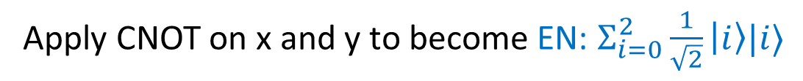
Example proof using Qafny type (CNOT).
x
y
Apply CNOT on x and y to become EN: $Σ_{i=0}^{2}\frac{1}{\sqrt{2}}\left|i\right\rangle |i⟩$
Notes:
Then, Qafny will apply the CNOT on x and y to become entangled together. A CNOT gate (or Controlled Not gate) will flip a qubit if (and only if) another qubit is set.

Slide 44
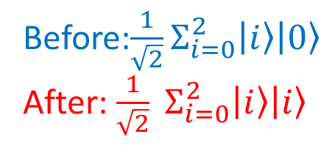
After the CNOT gate application.
Before:${\frac{1}{\sqrt{2}}Σ}_{i=0}^{2}\left|i\right\rangle \left|0\right\rangle$
After: $\frac{1}{\sqrt{2}} Σ_{i=0}^{2}\left|i\right\rangle \left|i\right\rangle$
What happen?
Notes:
How does the cnot gate work? Before application, the first qubit is either 0 or 1 and the second is 0.

Slide 45
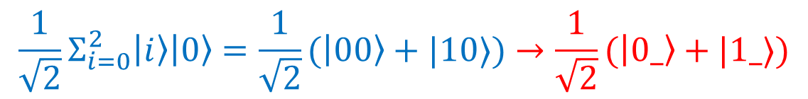
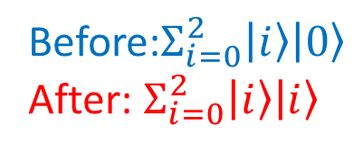
After the CNOT gate application.
Before:$Σ_{i=0}^{2}\left|i\right\rangle \left|0\right\rangle$
After: $Σ_{i=0}^{2}\left|i\right\rangle \left|i\right\rangle$
$${\frac{1}{\sqrt{2}}Σ}_{i=0}^{2}\left|i\right\rangle \left|0\right\rangle =\frac{1}{\sqrt{2}}(\left|00\right\rangle +|10⟩)→\frac{1}{\sqrt{2}}(\left|0_\right\rangle +|1_⟩)$$
Notes:
Here is it written out

Slide 46
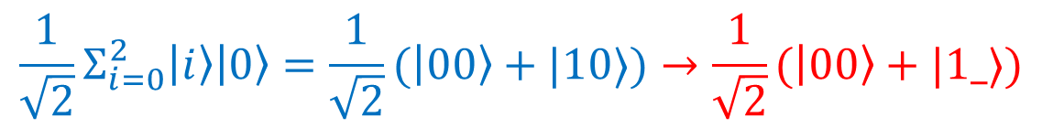
After the CNOT gate application.
If the first bit is 0,
then do nothing (same)
Before:$Σ_{i=0}^{2}\left|i\right\rangle \left|0\right\rangle$
After: $Σ_{i=0}^{2}\left|i\right\rangle \left|i\right\rangle$
$${\frac{1}{\sqrt{2}}Σ}_{i=0}^{2}\left|i\right\rangle \left|0\right\rangle =\frac{1}{\sqrt{2}}(\left|00\right\rangle +|10⟩)→\frac{1}{\sqrt{2}}(\left|00\right\rangle +|1_⟩)$$
Notes:
If the first bit is a zero, then nothing will happen.

Slide 47
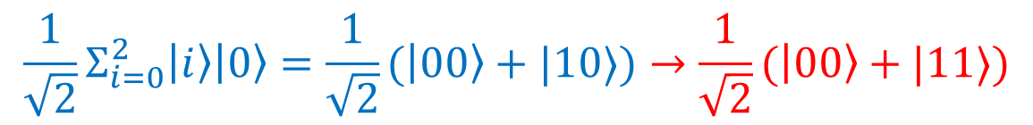
After the CNOT gate application.
If the first bit is 1,
then flip the bit.
Before:$Σ_{i=0}^{2}\left|i\right\rangle \left|0\right\rangle$
After: $Σ_{i=0}^{2}\left|i\right\rangle \left|i\right\rangle$
$${\frac{1}{\sqrt{2}}Σ}_{i=0}^{2}\left|i\right\rangle \left|0\right\rangle =\frac{1}{\sqrt{2}}(\left|00\right\rangle +|10⟩)→\frac{1}{\sqrt{2}}(\left|00\right\rangle +|11⟩)$$
Notes:
If the first bit is a one, then flip the second bit.

Slide 48
Abstract the circuit as a program.
x *= H ; if x then y += 1;
So, we can think of CNOT
as a conditional map operation:
For every ket state,
If the first bit is 0, do nothing,
If it is 1, then flip the bit.
x
y
x *= U means to apply U gate to x.
y += 1 is an aggregate add 1 to y’s every ket state by viewing it as an integer, here it flips the bit.
Notes:
The CNOT gate can be reasoned about as a program. x multiply equals H if x then y += 1; x multiply equals means apply a gate to x and y += 1 is an aggregate add of 1 to every ket state of by viewing it as an bitvector of length 1, so it flips the bit. We can think of CNOT as a conditional map operation. For every ket state, if the first bit is 0, do nothing, if it is a 1, flip the bit.

Slide 49
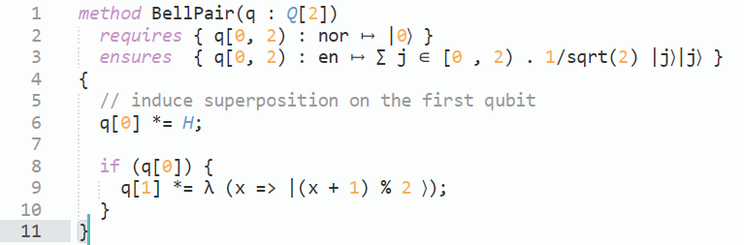
Qafny Code
Notes:
Here is what the code looks like in Qafny. We have a method declaration with some pre and post conditions (think assertions). The first condition (requires) specifies the state of the input (two qubits, both nor type, both 0). In the function body, we first apply a Hadamard. Then we do the controlled not operation. Line 8 corresponds to controlling on the first qubit and line 9 corresponds to flipping the second qubit. Finally, the second condition in the method declaration controls the output state (both qubits are now entangled and have the same state when measured).

Slide 50
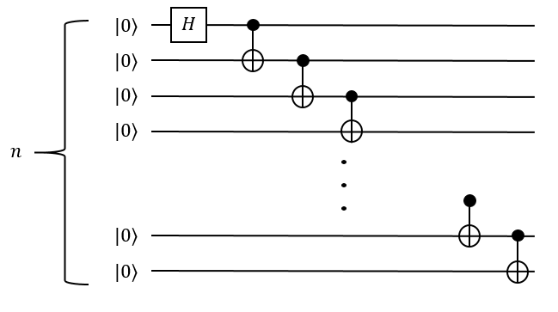
Works for general cases – GHZ.
x[0] *= H ; for (int i = 0; i < n-1 && x[i]; i++) x[i+1] += 1;
if x[i] then x[i+1] += 1
x[0..n] : n qubit array,
Initial type Nor.
Extended bell state prep.
Notes:
We can expand Bell Pair out into the generalized case, this is know as the Greenberger–Horne–Zeilinger (GHZ) state. It creates an entangled qubit string that is either all zeros or all ones when measured. The input is an n qubit array of type nor.

Slide 51
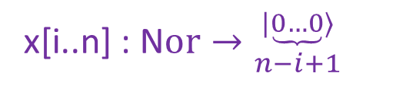
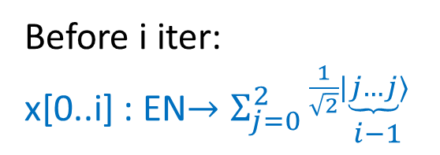
Works for general cases – GHZ.
Before i iter:
x[0..i] : EN$→Σ_{j=0}^{2}{\frac{1}{\sqrt{2}}|\underbrace{j…j}⟩ \atop i−1}$
x[0] *= H ; for (int i = 0; i < n-1 && x[i]; i++) x[i+1] += 1;
x[i..n] : N$or→{|\underbrace{0…0}⟩ \atop n−i+1}$
x[0..n] : n qubit array,
Initial type Nor.
i-th iter
Extended bell state prep.
Notes:
GHZ can be represented by an iterator, where before the ith iteration, everything prior to i is entangled (and either all 0 or all one in the ket) and after i, everything is of the nor type (and value 0).

Slide 52
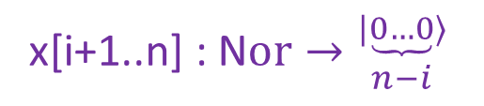
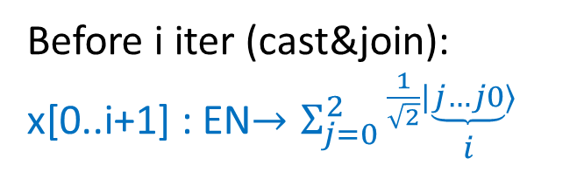
Works for general cases – GHZ.
Before i iter (cast&join):
x[0..i+1] : EN$→Σ_{j=0}^{2}{\frac{1}{\sqrt{2}}|\underbrace{j…j0}⟩ \atop i}$
x[0] *= H ; for (int i = 0; i < n-1 && x[i]; i++) x[i+1] += 1;
x[i+1..n] : N$or→{|\underbrace{0…0}⟩ \atop n−i}$
x[0..n] : n qubit array,
Initial type Nor.
i-th iter
Extended bell state prep.
Notes:
Again, we cast and join the values.

Slide 53
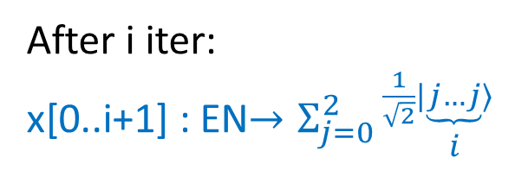
Works for general cases – GHZ.
Invariant restored!
After i iter:
x[0..i+1] : EN$→Σ_{j=0}^{2}{\frac{1}{\sqrt{2}}|\underbrace{j…j}⟩ \atop i}$
x[0] *= H ; for (int i = 0; i < n-1 && x[i]; i++) x[i+1] += 1;
x[i+1..n] : N$or→{|\underbrace{0…0}⟩ \atop n−i}$
x[0..n] : n qubit array,
Initial type Nor.
i-th iter
Extended bell state prep.
Notes:
And then after the i-th iteration, everything up to and including i is entangled (and the basis ket is either fully zero or fully one) and everything after i is still of the nor type (and value 0). Thus the invariant is restored for another loop!

Slide 54
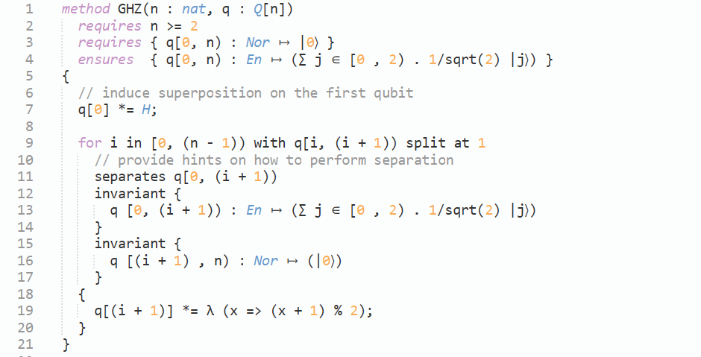
GHZ Code
Notes:
Here is GHZ represented in Qafny.

Slide 55
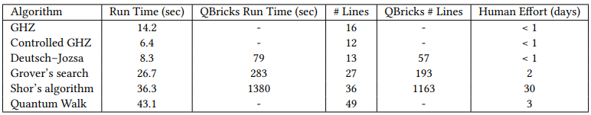
Qafny Evaluation
An example implementation of Qafny is on Dafny.
Faster running time compared to previous quantum proof system.
Less proof specs.
Save human labors.
Notes:
As a result of this research paper, a working example implementation of Qafny has been built on top of Dafny. Preliminary trials have already shown a faster running time compared to previous quantum proof systems. (in the table, this is compared to QBricks), research has also shown less proof specs and less human labor required (see the # of lines for qafny as compared to the number of lines for qbricks in the table).

Slide 56
Qafny Remarks
An example implementation of Qafny is on Dafny.
Build with the type system.
View quantum states as the three types.
View quantum ops as array aggregate ops in Dafny with additional theorems.
Type-driven insertions of casting operations.
Qafny is also a quantum language.
Compile the language to quantum circuit.
Correctness statement is based on quantum semantics.
Dual views of Qafny with respect to its utility!
Notes:
In this talk we have demonstrated the features of Qafny including how it is built with the type system, represents quantum states as three distinct types, uses array aggregate operations to verify quantum operations with additional theorems and abstracts away implicit casting between different quantum types. Qafny is also more than capable of fulfilling the true purpose of a quantum language as it can be compiled to a quantum circuit such as SQIR and QASM and it’s correctness is based on quantum semantics.

Slide 57
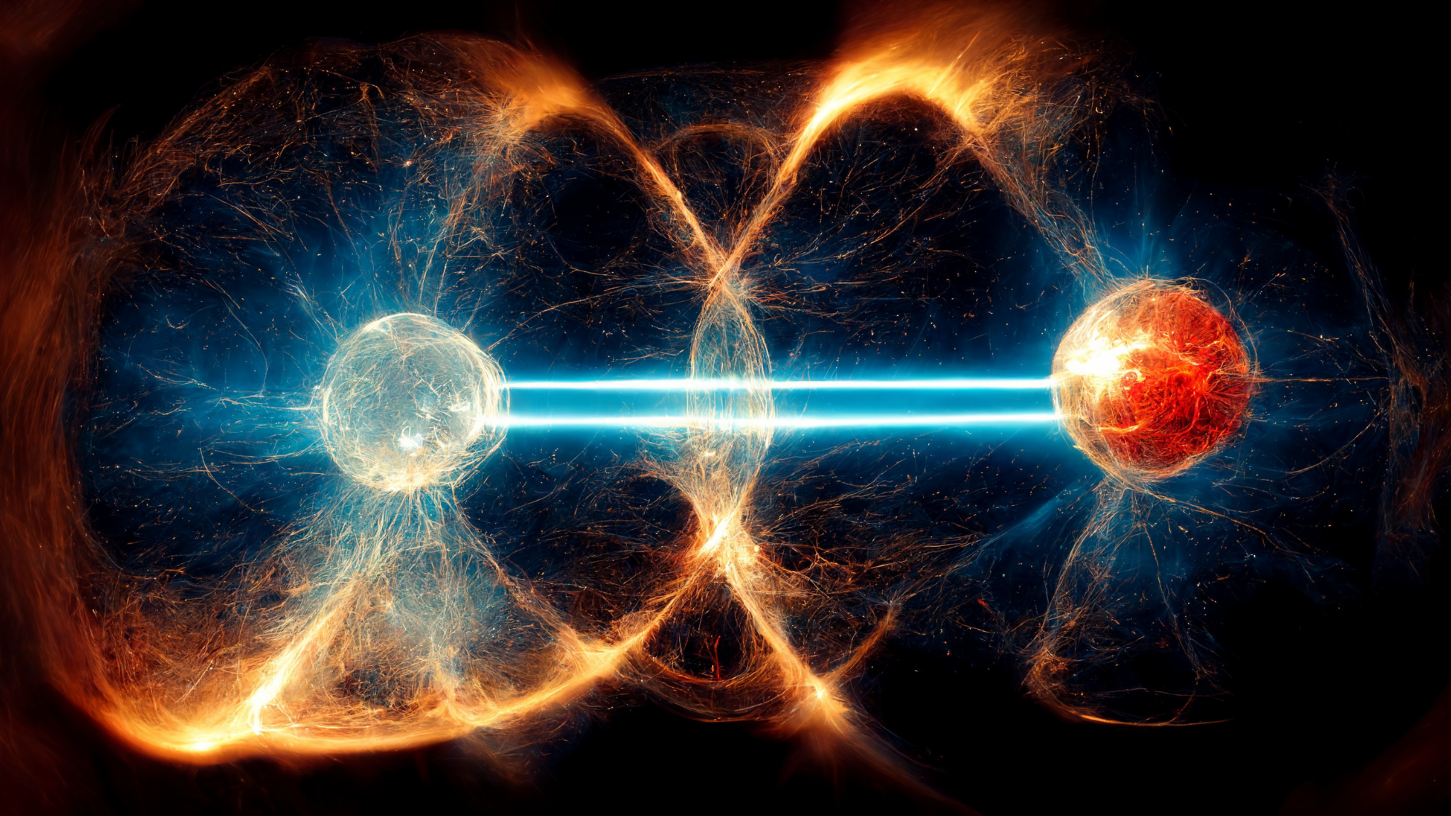
Future Work
Qafny will assist in developing quantum programs faster and with fewer bugs.
Expanding Qafny to cover more use cases.
Using symbolic execution to help generate pre/post conditions for algorithms.
Notes:
In the future, Qafny can be applied to:
More complicated problems (Amplitude amplification, Amplitude Estimation)
Cover more quantum proving ground
Using symbolic execution to assist in writing pre and post conditions for algorithms.

Slide 58

Thank You!

